Slide 1
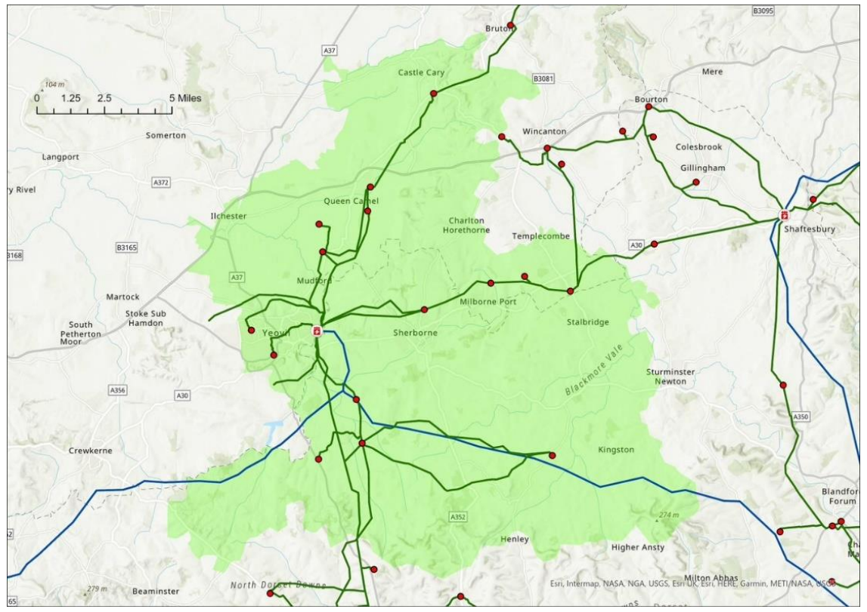
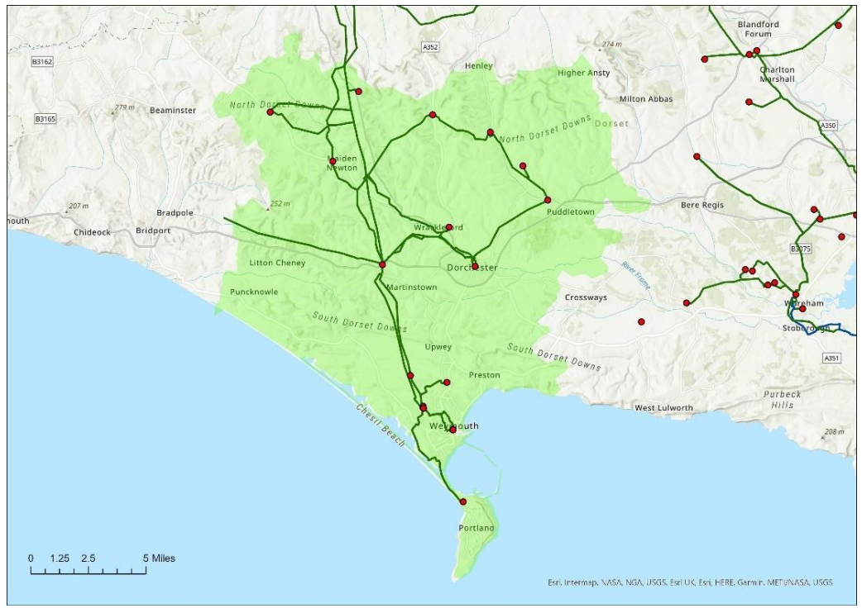
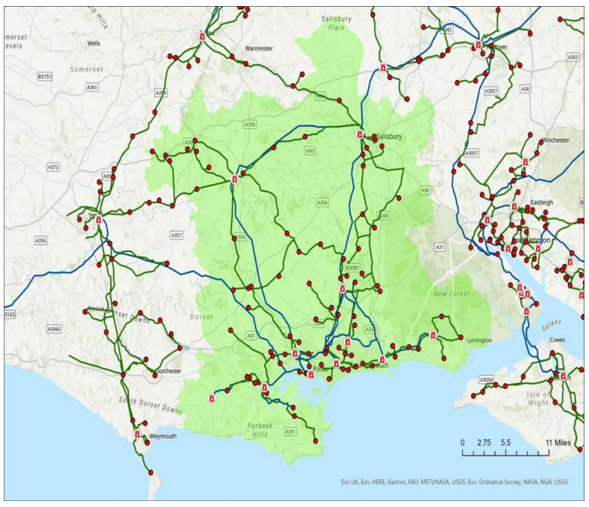



Grid Capacity & Energy Planning
16 October 2023
Notes:
Good evening all. Thanks for joining us today.
I’m Carl Warom, policy officer in the Sustainability Team; and I’m joined by the sustainability team manager, Ant Littlechild, who I’m sure many of you know.
This evening I’m going to try and cover two things:
First, to introduce the issue of electricity grid capacity constraints.
And second, to talk about a couple of forthcoming opportunities to better strategically plan for energy infrastructure which will strengthen the council’s role in influencing investment in the grid.

Slide 2
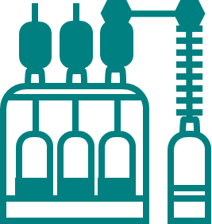
What am I doing here?
Energy policy isn’t just about how we generate it. The grid is of critical strategic importance too – for development, housing, economic growth, transport, and net zero.
  There’s significant strategic risks associated with the grid, and they threaten to worsen as more sources of demand and supply aims to connect.
  There is a major programme of reform underway nationally from Government, Ofgem and network companies.
  This presents significant opportunities for the council to play a more strategic role in the planning of the future energy system.
1
2
3
The Place and Resources Scrutiny Committee undertook a deep dive into the issue earlier this year. Today I’ll (a) recap some of their findings; and (b) update you on some progress around energy planning.
Notes:
Before I begin, I should give a caveat or warning. The grid, as topic, has the treble vice of being both highly technical, quite boring, and something in which we have no statutory duty to play any role whatsoever.
For that reason, you might think, why am I here listening to you ramble on about it on a Thursday evening?
Well, as I’ll try to convince you, it is of fundamental strategic importance for our ambitions on development and housing, economic growth, transport and net zero.
As we all know, the energy crisis threw into sharp relief the challenges posed by the UK’s lack of energy self-sufficiency – and strengthened national ambition to transition from volatile and costly fossil fuel imports to an energy system that is cleaner, more secure, and more affordable. That has catalysed national action to shift how the country generates, stores and transports electricity – and the framework that regulates it all. Government and Ofgem have, consequently, released many many policy documents and reform proposals over the last couple of years on how to get towards that – including for the national ambition to decarbonise the grid by 2030.
Much of the public conversation about energy is dominated by talk about deploying renewables. But just as important is ensuring that the grid itself is fit for purpose to absorb new local generation, as well as the significant growth in electricity demand expected from the electrification of heat and transport.
That’s because, ultimately, a constrained grid that lacks capacity to absorb new supply and demand presents barriers to our achievement of new development, economic growth and net zero alike. And whilst it’s a problem for everyone nationally, it’ll of course have locally-specific contours that mean we have strong interests in ensuring that how the grid evolves, and what is invested in, is aligned to our own local needs in Dorset.
Nor is this just a problem for the future: some of our programmes, and those of other local stakeholders, have already faced delays, curtailment or cancellation owing to prohibitive connection costs or grid strengthening delays which impaired project viability.
But this could get more significant in the future and threaten key opportunities. Our Great South West prospectus, for instance, identifies that the region could generate 11% of the UK’s electricity capacity, but this urgently needs strategic investment in the grid and policy reform to realise it.
Now network operators already do forecast constraints and produce investment plans to try and address them, as I’ll outline – and we as officers feed into these processes. But the reforms now give opportunities for us to play a strengthened role in the future.
For all these reasons, earlier this year a cross-party task & finish group of our place and resources scrutiny committee did a deep dive into the issue. For their sins, they endured five 3-4hr sessions, and in the process heard from council officers, renewables developers, retrofitters, housing developers and housing associations, and network companies themselves. So thank your lucky stars that I’m only talking to you for an hour - and apologies if any of them are present and get flashbacks.

Slide 3
Agenda:
Background on the grid and investment
The Scrutiny report’s key findings
Strategic Energy Plans
Q&A

Slide 4
1. Background on the grid and investment

Slide 5





















What is the grid?
Policy framework
Regulator
Transmission Network Operator
Generators
Transmission network
(High voltage)
275/400kV
Energy System Operator (balancing)
11kV
33/66kV
132kV
Distribution network
(Low voltage)
Distribution Network Operators (DNOs)
Distribution Substations (LV)
Primary Substations (PSS)
Bulk Supply Points (BSP)
Grid Supply Points (GSP)
Feeder lines
230/400V
*Formerly WPD
Energy suppliers
End consumers
Notes:
So, to begin. What is the grid? The grid is the complex network of infrastructure responsible for carrying power from where it’s generated to the point of consumption by a home or business. In a nutshell, it comprises a system of overhead lines, underground cables and substations.
Historically, most electricity has been generated at large power plants and generators, which is then transmitted and distributed via the grid.
There are two types of network which make up the two halves of the grid:
Transmission networks are the high voltage networks that carry energy long distances from major large-scale generators to local area substations.
Distribution networks are the lower voltage networks that then carries it for the final part of its journey to homes or businesses.
The two are bridged by substations, which convert high-voltage electricity from the transmission network to a lower voltage so that it can be safely distributed to end users.
Think of the transmission network as like a motorway (high speed, long-distance), and the distribution network local highways (lower speed, shorter-distance).
Some larger generation and demand sources connect directly to the transmission network; but most under 50MW will connect to the distribution network.
Power isn’t converted from high to low voltage in one step, but is in fact stepped down in multiple stages through different kinds of substation on its journey to homes and businesses: at Grid Supply Points, Bulk Supply Points, Primary Substations, and final Distribution Substations.
The main operational roles for the grid are:
The role of Transmission Network Operator, which owns and maintains the transmission network – that is fulfilled by National Grid.
The role of Energy System Operator, which manages and plans the supply and demand balance to ensure the network is stable and secure. In England this is fulfilled by National Grid ESO, a separate company – and is transitioning to a new none-profit, public National Energy System Operator (NESO)
And the role of Distribution Network Operators – who are licensed distributors which own and maintain the distribution network in specific areas.
The system is governed by government and the regulator:
The Department for Energy Security and Net Zero sets the policy and legislative framework;
and Ofgem sets the regulatory framework; licenses generation, transmission and supply; and approves strategic investment plans. As the system is a monopoly, it also has a role in enforcing price controls to protect consumers.
Energy suppliers are distinct from all of these. They buy electricity from the market and sell it onto consumers – so suppliers are an intermediary between consumers and the grid. They forecast what customers electricity needs are and buy an expected amount from the wholesale market. Discrepancies between that and actual demand are managed by National Grid’s balancing services.

Slide 6








How is the grid changing? Decentralisation
The old network
Top down, centralised, unidirectional
Balancing:
Energy System Operator
Electricity storage
Distributed generation
The new network
Complex, distributed, multi-directional
Consumer generation
Balancing:
Future System Operator
Balancing:
Distribution Systems Operators
Electric vehicle charging & heat pumps
Notes:
So how is the grid changing? There are really two main challenges to focus on: decentralisation and demand growth.
First, decentralisation. Historically power generation has happened remotely from large settlements, and the grid was designed to have electricity coming one way from a centralised source, through a top-down system.
But increasingly the system is becoming more decentralised and multidirectional, due to:
First, the connection of many more local generators which are plugging directly into the distribution network (what are known as ‘embedded’ generators), like commercial or community-owned renewables or those installed on homes like rooftop solar.
And, second, the expected increase in flexible technology like batteries and vehicle-to-grid chargers that can store and export energy back to the grid
This matters for two reasons:
First, infrastructurally, it means increasing demand for connections to the grid, which can in turn prompt the need for ‘reinforcements’ to the network to ensure that it is capable of absorbing them.
Second, operationally, the grid needs to be highly responsive to balance – reacting dynamically in real-time to match supply and demand. If they don’t match there’s a risk of outage or a change in the network frequency or voltage that can cause damage (think of it as like maintaining water pressure). Before, we only really needed National Grid to do that balancing nationally as supply was centralised, but now local network operators are having to take on that role too.

Slide 7

How is the grid changing? Demand growth
Demand could double by 2050, including…
700
600
500
400
300
200
100
0
Potential new electricity demand to 2050
(TWh, Balanced Pathway scenario)
Source:
Baseline
Surface transport
Residential buildings
Non-residential buildings
Manufacturing & construction
Fuel supply
Other
Total
Notes:
The second main challenge is the scale of expected demand growth.
The key point is just that demand could double to 2050 due to new developments and the decarbonisation of heating and transport.
The magnitude, speed and composition of that demand growth varies depending on what scenarios you consider – more on scenarios shortly – but hopefully this just illustrates the general point that demand is expected to grow significantly, and that means more supply is needed and more pressure on the grid to accommodate that additional demand and supply.
Network operators will therefore need to invest billions to upgrade network infrastructure and build that capacity – and local influence will be vital to help direct exactly where the investment needs to go.

Slide 8
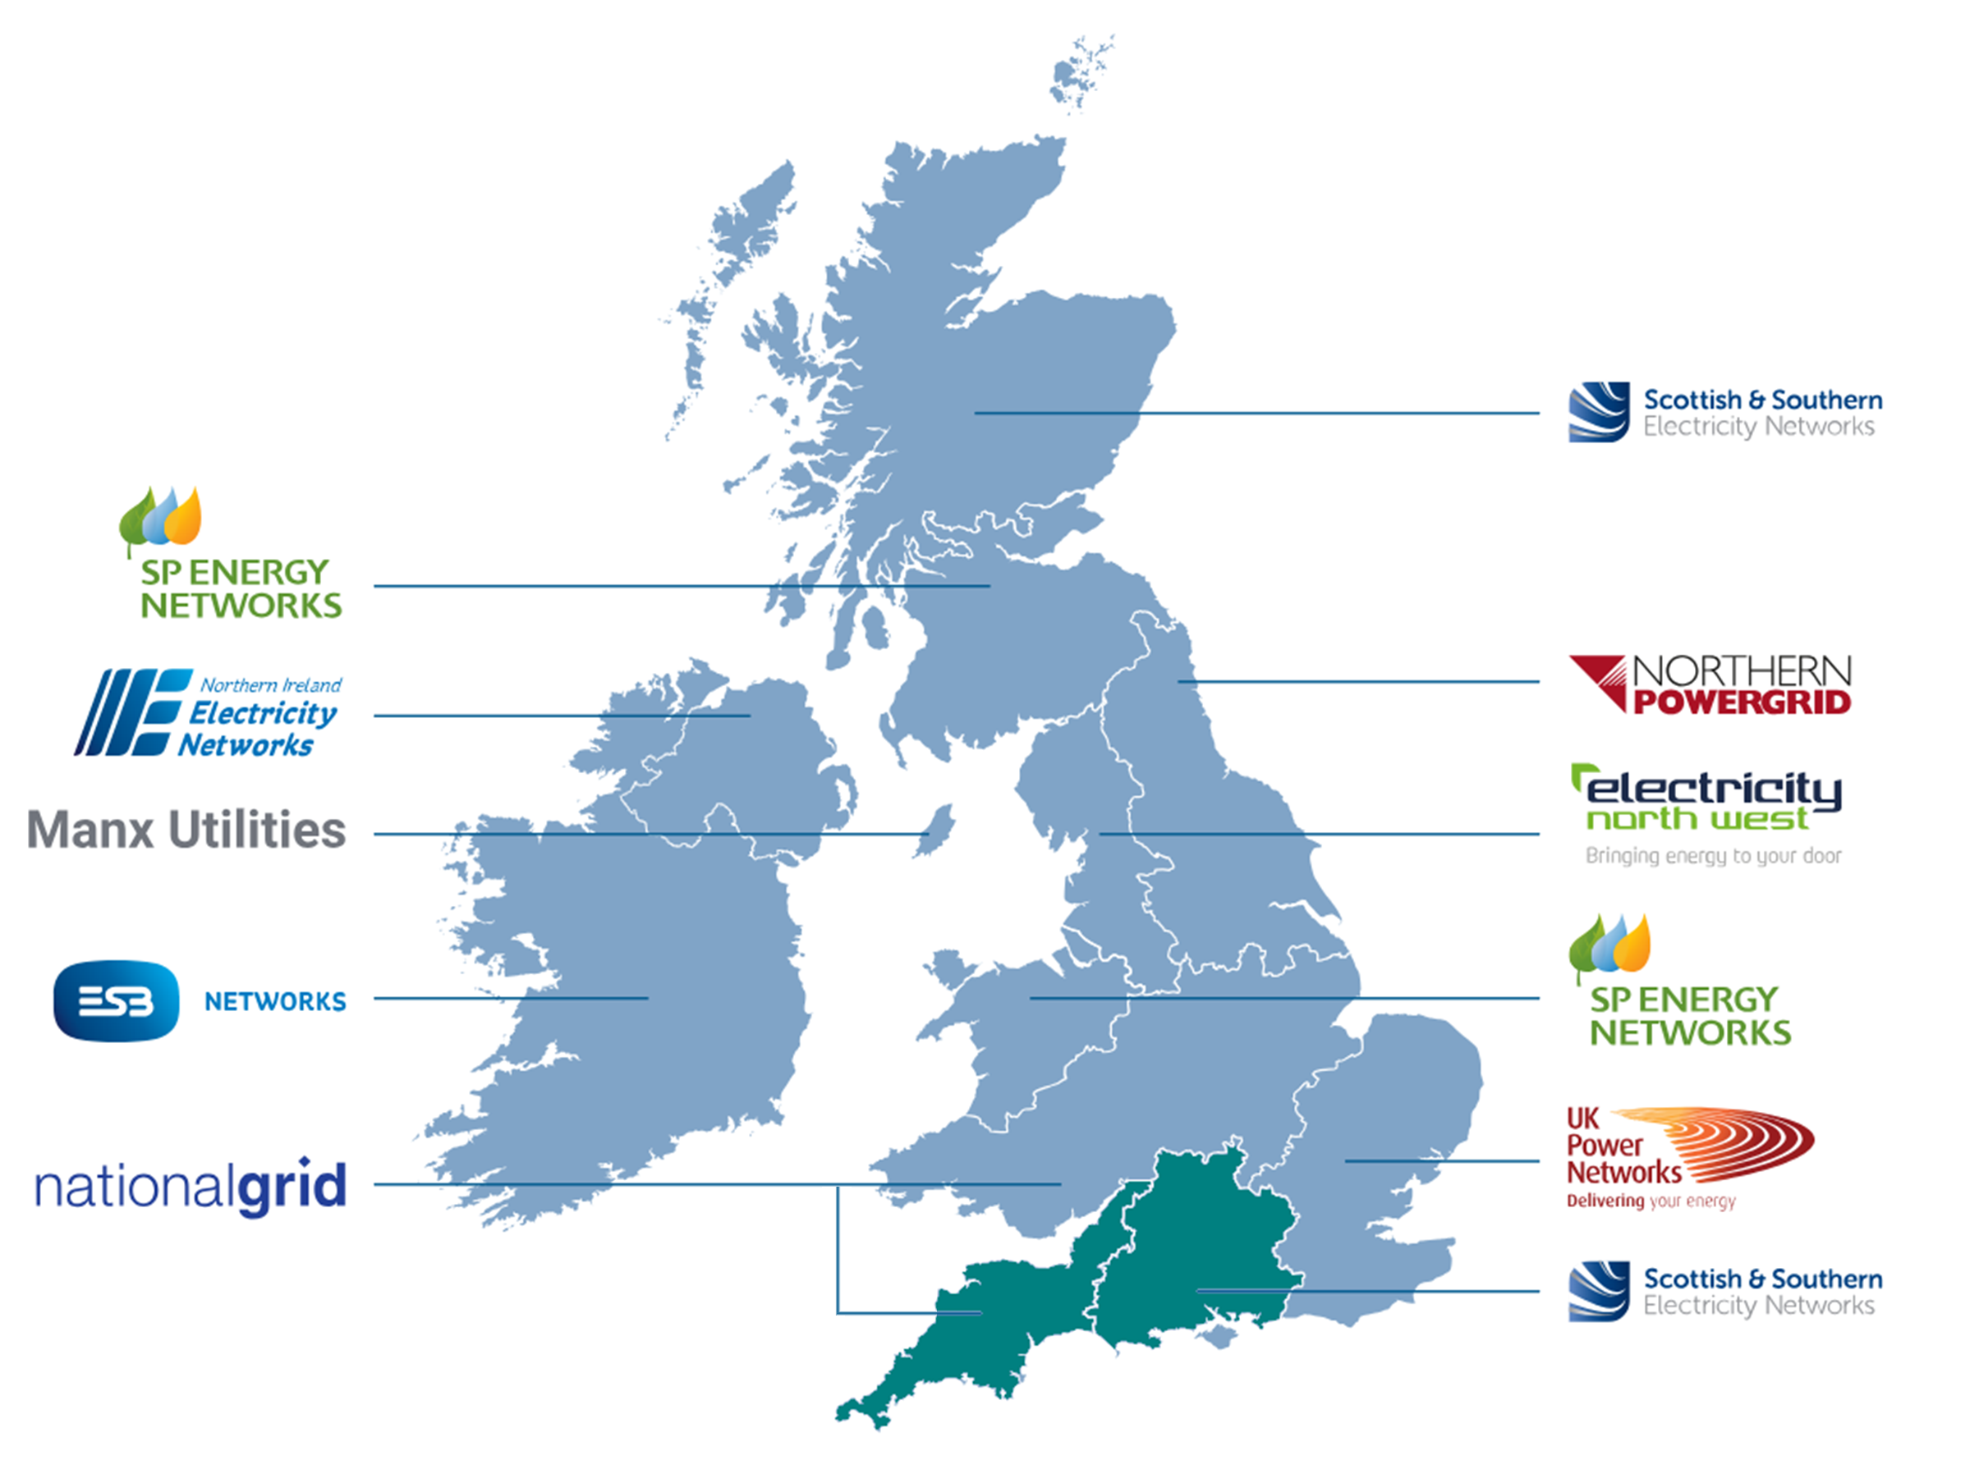

What are DNOs? License areas
Dorset’s Distribution Network Operators (DNOs) are
Scottish & Southern Electricity Networks (SSEN)
National Grid Electricity Distribution (NGED)
Notes:
Whilst there’s only the national grid operating the transmission network, there are lots of different network operators for the more local distribution networks – called the Distribution Network Operators, or DNOs. Remember, these are not energy suppliers, and most consumers don’t engage with them directly at all.
These are instead licensed distributors who own & maintain local distribution networks in specific ‘license areas’ – energy suppliers are distinct intermediaries between the network operators and consumers. In Great Britain six DNOs run fourteen license areas. These areas aren’t really distinct systems, so power can flow between them and these volumes are measured – but they mark who is responsible for maintaining them.
As you can just about see from this map, the license areas don’t correspond nearly to county boundaries. As such, Dorset has two DNOs depending on where you are: Southern and Scottish Energy Network (SSEN) and National Grid – and the areas which they each cover expand far beyond Dorset, across the Southern and South Western license areas respectively. SSEN’s Southern area, for instance, covers 53 different local authorities.
And if I zoom in a bit…

Slide 9
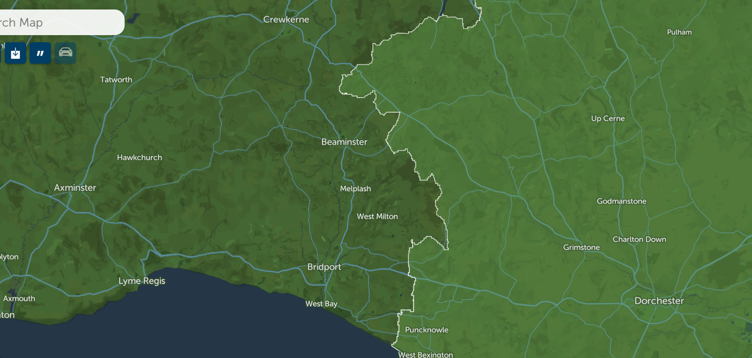
Dorset’s two DNO areas
Dorset’s Distribution Network Operators (DNOs) are
Scottish & Southern Electricity Networks (SSEN)
National Grid Electricity Distribution (NGED)
Notes:
You can see the boundary between the two areas here.
So SSEN covers all most all of Dorset – all but three of our substations in the west, which are operated by National Grid.

Slide 10
How is demand forecast? Business planning
Dorset’s key grid infrastructure
Grid Supply Points
Axminster
Chickrell
Mannington
Bulk Supply Points (13)
Bournemouth
Chickerell
Christchurch
Lytchett
Mannington
Poole
Redhill
Salisbury
Shaftesbury
Wareham
Winfrith heath
Yeovil
Woodcote (NGED)
Primary Substations (53)
Christchurch | Hamworthy | Bourton | West Hendford
Blandford | East Howe | Gillingham | Yeovil
Corfe Mullen | Redhill | Shaftesbury | Cerne Abbas
Creekmoor | Homington | Shroton | Charminster
Winterbourne Kingston | Gussage St Michael | West Stour | Chickerell
Ferndown | Minchington | Wincanton | Dorchester Town
Fordingbridge | Tarrant Rushton | Parkstone South | Maiden Newton
Hinton Martell | Henstridge | Bovington | Redlands
Mannington | Pulham | Bushey | Weymouth
Mill Lane, Ringwood | Sherborne | Swanage | Portland
Rockbourne | Yetminster | Wareham Town | Beaminster (NGED)
Verwood | Piddletrenthide | Chilton Cantello | Bridport (NGED)
Wimborne | Puddletown | Milborne Port | Penn Cross (NGED)
Wimborne St Giles
Notes:
There are 3 Grid Supply Points (Axminster in the west, Chickrell near Weymouth, and Mannington out East), and these are owned by National Grid Transmission.
SSEN is the Distribution Network Operator for most of Dorset, as I said, with a small section to the west controlled by National Grid Electricity Distribution.
The assets of most relevant to Dorset include these 13 Bulk Supply Points and 53 Primary Substations.
Those few at the bottom of the lists belong to NGED as indicated – all the rest are SSEN’s.
In addition to the lines and cables connecting them, this is much of what we’re talking about when we refer to the distribution network in Dorset – and much of whose capacity we’re interested in when we talk of constraints.

Slide 11
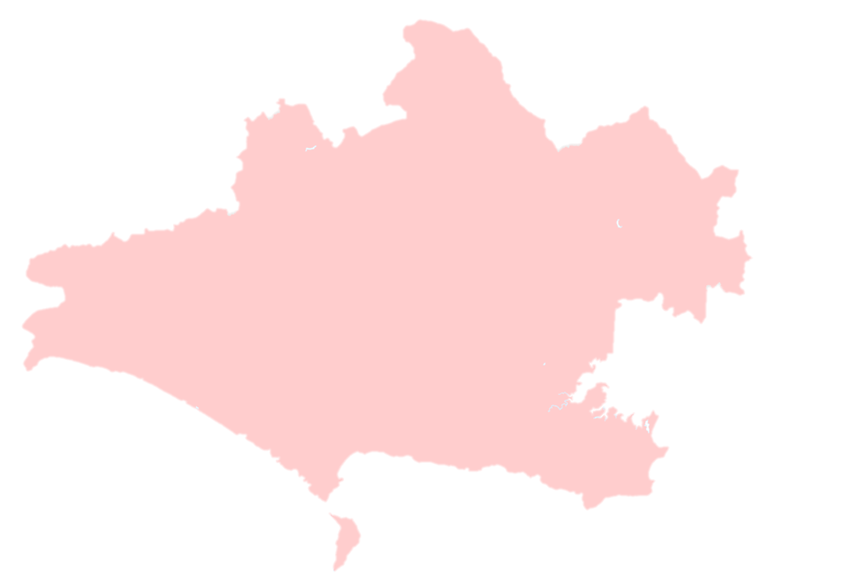
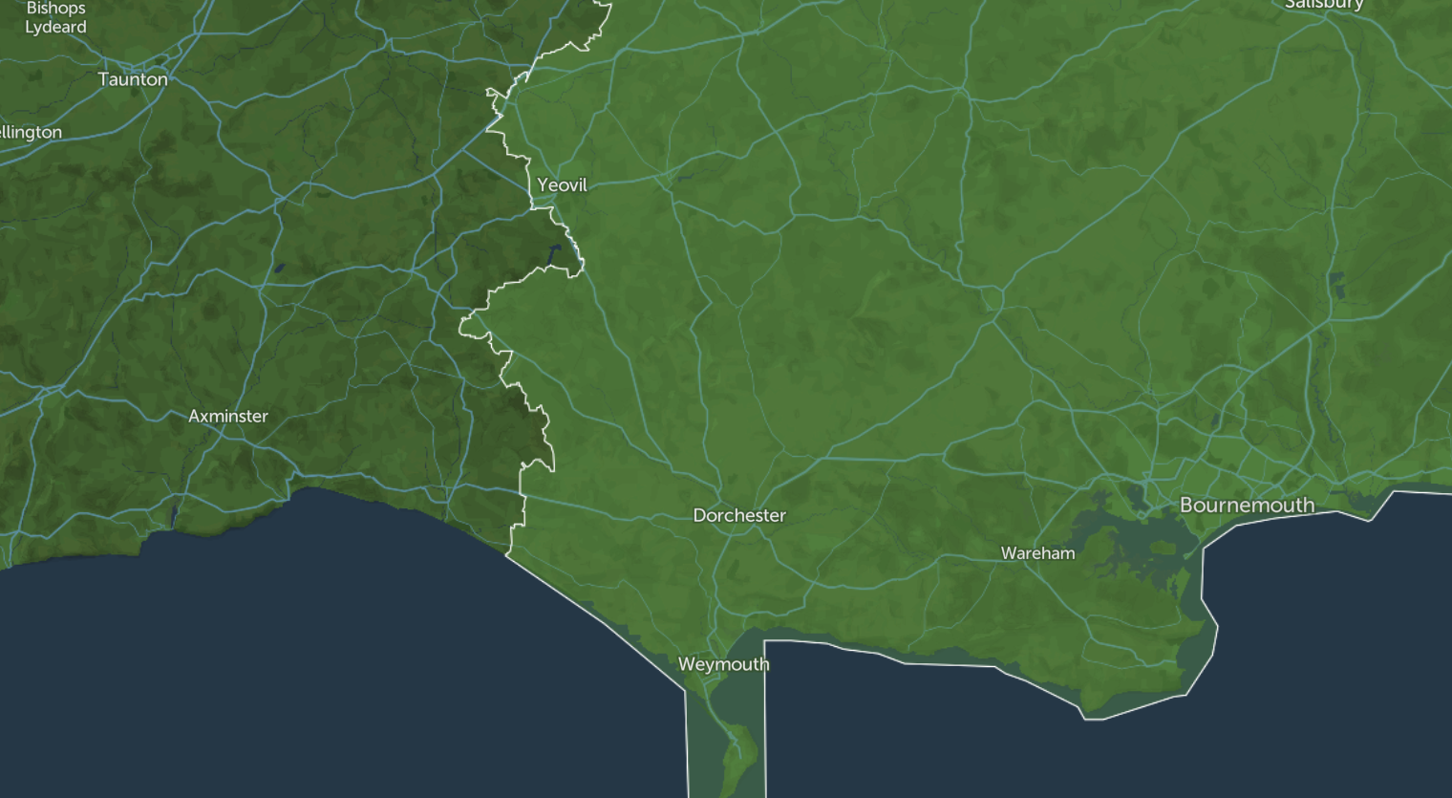


Salisbury BSP
Shaftesbury BSP
Yeovil BSP
Mannington GSP
(Supplies all other BSPs - ~408,000 customers)
Axminster GSP
(supplies Yeovil BSP - 47,400 customers)
Woodcote BSP (NGED)
Redhill BSP
Lytchett BSP
Poole BSP
Wareham BSP
Winfrith Heath BSP
Chickerell BSP
Chickerell GSP
(supplies Chickerell BSP – 62,000 customers)
Notes:
This is the location of the 3 Grid Supply Points alongside the Bulk Supply Points.
It’s too dense to try and show the Primary Substations on here, but you can explore this map online and I’ll share the link for that.

Slide 12
How is demand forecast? Business planning
Dorset’s key grid infrastructure
Axminster GSP
Supplies Yeovil BSP >47,000 customer
Chickerell GSP
Supplies Chickerell BSP >62,000 customers
Mannington GSP
Supplies all other BSPs ~408,000 customers
Notes:
But – appreciating this is too hard to see the detail on here – this is the detail.
Essentially, there are three areas being served by the three respective grid points.
The big one is of course Mannington, which covers most of the substations and customers.

Slide 13
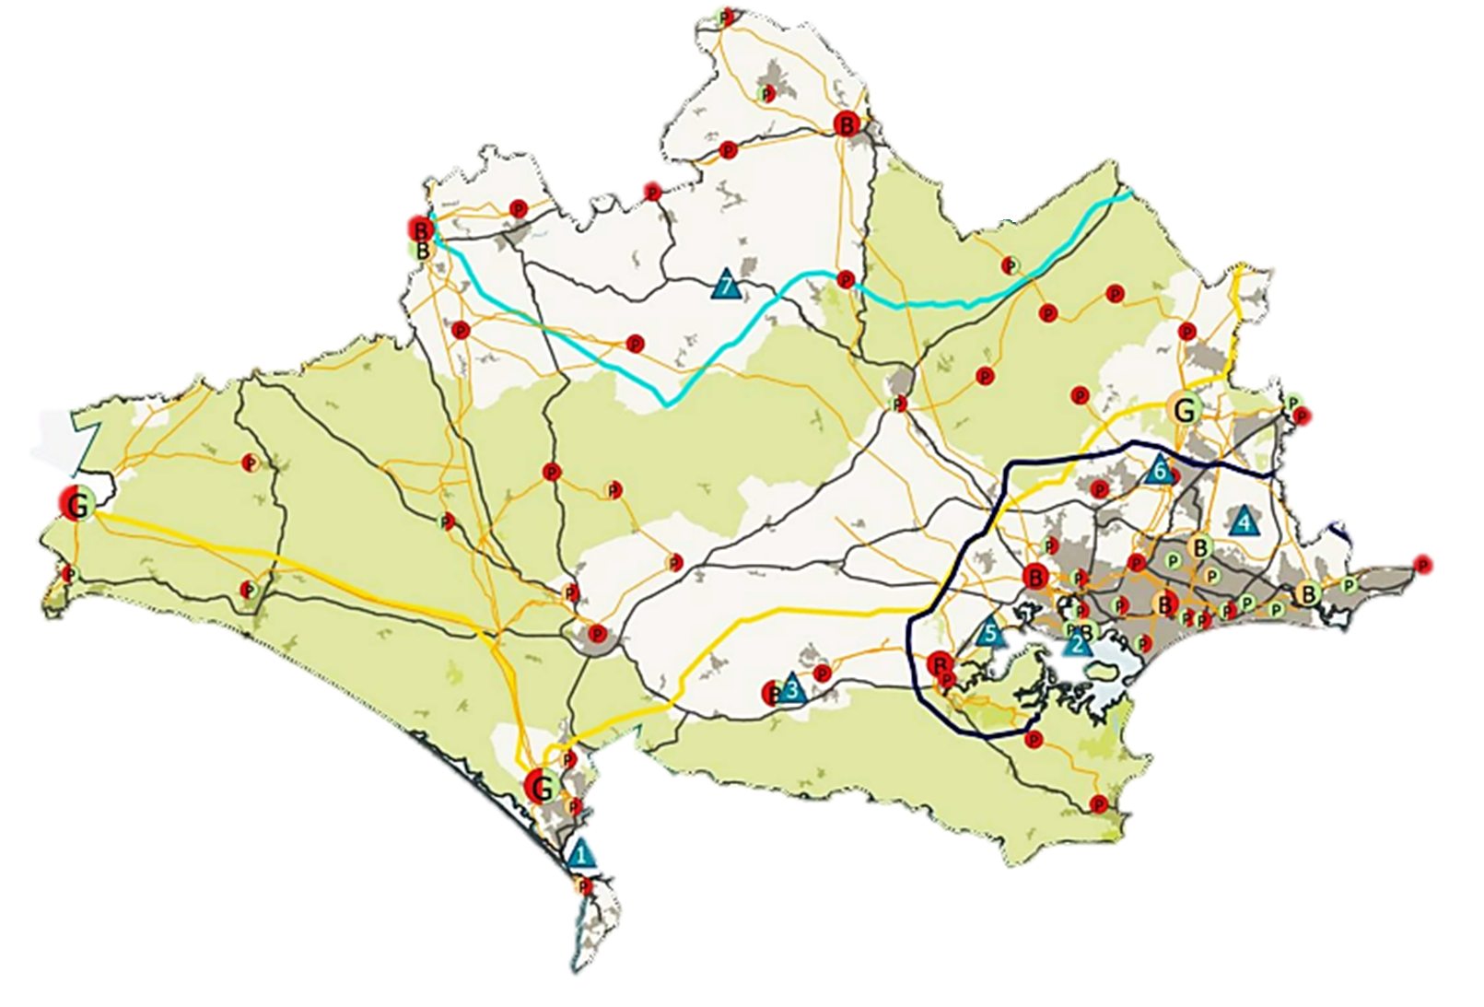
How is demand forecast? Business planning
What are the constraints in Dorset?
Substations in the centre are constrained for supply and demand
Distribution network
North Dorset Business
Park
Transmission network
Ferndown Industrial Estate
Part constrained
Constrained
Unconstrained
Demand
Supply
Bournemouth Airport
Holton Heath Bus Station
Grid supply point
G
G
G
Poole Port
B
B
B
Dorset Innovation
Park
Bulk supply point
Substations in the west are constrained for supply but not demand
Many BCP substations are demand constrained but have supply headroom
Primary substation
P
P
P
Portland Port
Notes:
And in a nutshell, capacity in Dorset is already constrained, and this is inhibiting project delivery and resulting in the delay, curtailment or cancellation of projects to to prohibitive costs or delays impairing project viability. This is also impacting economic development in areas like Bridport, Weymouth Granby, Portland Port, Holton Heath industrial Estate, & North Dorset Business Park.
We commissioned our own Grid Capacity Assessment as part of the evidence base for the local plan, to identify probable areas of constraint. That found that several local substations are forecast to exceed current capacity by 2030, especially around Chickerell and Dorchester – and by 2040, capacity is exceeded at most substations.
That report – and this diagram – are not really up to date now – so as I said, I’ll point you to more up to date resources at the end.

Slide 14



What are DNOs? Upgrades and costs
DNOs have a responsibility to ensure capacity and cost-effective reinforcement to lines, cables or substations.
That may result from…
Incremental demand growth
New connection requests
Forecast demand growth
Customers partly bear the costs for upgrades through…
Distribution Use of System (DUoS) charges:
Ongoing charges paid by all network users for ongoing operations and reinforcements needed for incremental increases
Connection charges:
One-off costs invoiced to customers directly to recover part of the costs of requested new connections
Notes:
So how are these constraints managed? And what do these DNOs do if they’re not energy suppliers?
In short, they have a responsibility to ensure capacity for future demand and cost-effective reinforcement. That may be through upgrades to expand or install new substations, overhead lines or underground cables – or through flexibility measures that try and make most efficient use of capacity by better matching supply and demand.
As regards infrastructure upgrades, generally, the higher up the grid you go (from Primary Substations to Bulk Supply Points to Grid Supply Points) the more expensive and time-consuming works are.
Reactive reinforcement may be required due to either incrementally greater demand from existing connected customers, or by being triggered by requests for new connections from new larger sources of demand or supply. But not every new connection will require an upgrade through reinforcements.
DNOs help provide projects with estimates of the costs and options if they require reinforcements – and areas of constrained capacity can be more expensive to connect to.
Any reinforcements that are not triggered by a new connection request are assessed and approved by Ofgem, as the cost is recovered from all customers. Importantly, Ofgem now allows for proactive reinforcement of the network in anticipation of future demand if evidenced – I’ll say more about that shortly.
Network operators and customers share the costs involved. Customers can bear the costs in two possible ways:
Distribution Use of System (DUoS) charges are ongoing charges paid by all electricity consumers, which are for managing incremental increases and anticipatory investment. They are paid indirectly to network operators via energy suppliers (as a part of the ‘network costs’ element of a customer bill). Similar such charges apply for the transmission network.
Connection Charges are one-off costs invoiced to connecting customers only (i.e. those connecting a new big source of supply or demand), and are paid directly to recover part of the costs of requested new connections. These costs are outlined in a connecting customer’s Connection Agreement.
There was a lot of reforms to how the charging regimes changed over the last year or so – including, for connection charges, the removal of charges from demand customers and a reduction of costs for new generators – and there’s an ongoing process of reform underway for DUoS charges.
Please don’t ask me about this, as I’m not up to date on it and it’s insanely complicated.

Slide 15

What are DNOs? DSOs and flexibility
Local operators will take on a larger role in balancing supply and demand on the distribution network. This is called the ‘DNO-DSO transition’, as they’re moving from Distribution Network Operators to Distribution System Operators.
Electricity storage
Distributed generation
Consumer generation
Smart EV charging & heat pumps
Flexibility, smart tech and demand-side response solutions will be important to consider alongside reinforcements as a factor in managing capacity – not just ensuring that there is more capacity, but that we make most efficient use of it
Notes:
As I briefly just said though, upgrading infrastructure is not the only thing that DNOs do – and not the only way they manage constraints.
They are also increasingly playing an operational role in balancing supply and demand locally, and thereby transforming into Distribution System Operators, in what is called the ‘DNO-DSO transition’.
This means that managing capacity isn’t just about grid infrastructure upgrades, but also ensuring more flexibility in the system to help match supply and demand. Flexibility systems like battery storage, demand-management and real time data from smart tech (like smart meters, EV chargers and heat pumps) will enable them to better manage demand and supply on the local network in real time. This will help to mitigate the need for (and costs associated with) network upgrades – ensuring we’re not just expanding network capacity; but making more efficient use of it too
That’s why things like new battery storage facilities matter. But it’s not just about those big standalone facilities: it could also provide opportunities for customers (households and businesses) to play a more active role in how the system is balance by, for example, getting paid to adapt their demand, supply power which they generate themselves, or to store electricity if they have the means.
That will present opportunities in the future for our resident households and businesses to benefit form emerging flexibility markets – especially when more smart heat pumps and EV chargers come on the market, which will allow electricity to be exported back into the grid. There’ll be important questions about fairness here too, to ensure that everyone who wants to participate can.
More generally, the key point here is that flexibility matters as well as grid infrastructure upgrades: it’s not just about expanding capacity, but making more efficient use of it.

Slide 16
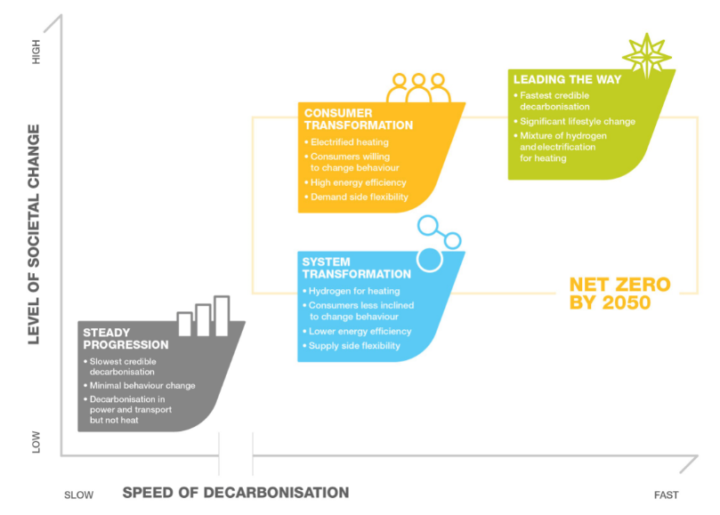
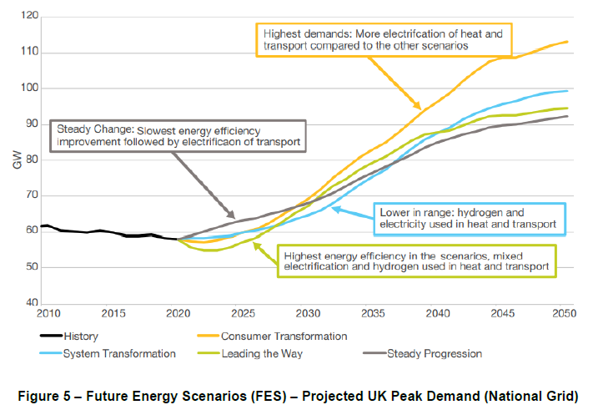
How is demand forecast? Future Energy Scenarios
The four national scenarios
Projected peak demand
Notes:
Now, what network operators choose to invest in – whether it’s infrastructure or flexibility measures – depends upon what they forecast future demand and supply to look like, and where they expect it to be. To do that, they do very detailed energy system forecasting.
At the national scale, National Grid prepares Future Energy Scenarios for the transmission network annually, which outline four potential pathways to 2050.
Each scenario essentially describes a different way to decarbonise the grid – and so make different assumptions over key variables like the extent of investment, household efficiency retrofitting, EV take-up, and the relative role of hydrogen boilers and heat pumps.
Consumer Transformation focuses more on changing the way we use energy…
System Transformation focuses more on changing how energy is generated and supplied.
Leading the Way describes the fastest feasible trajectory that is a mix of those two, involving a mix of high consumer engagement, innovative tech and high investment to get to net zero before 2050.
And Steady Progression is the slowest – and violates our national statutory carbon budget and the Paris Agreement.
They correspondingly have different implications for expected peak demand, as shown on the right.
It’s worth noting here too that whilst the transition will significantly increase electricity demand, decarbonising is an opportunity to significantly cut overall energy demand – and demand will need to be mitigated by significant energy efficiency improvements. As such, improving energy efficiency of buildings is part and parcel with managing grid constraints – the less efficient our buildings, the higher their energy demand, and the more pressure on the grid. That’s why when thinking about things like energy efficiency measures – whether done on our estate, our in Dorset buildings through programmes like Low Carbon Dorset and Healthy Homes Dorset – they’re not just saving on bills or cutting their emissions: they’re also helping to mitigate demand and therefore grid constraints too.

Slide 17
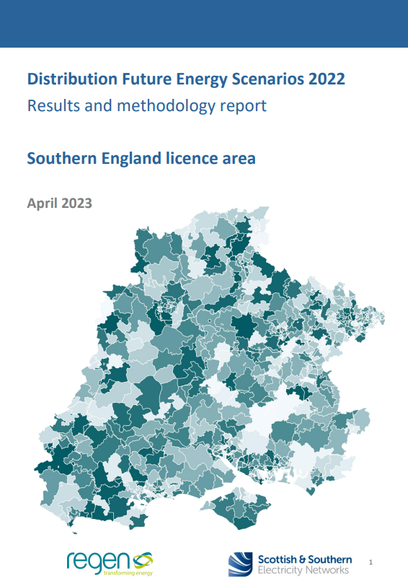
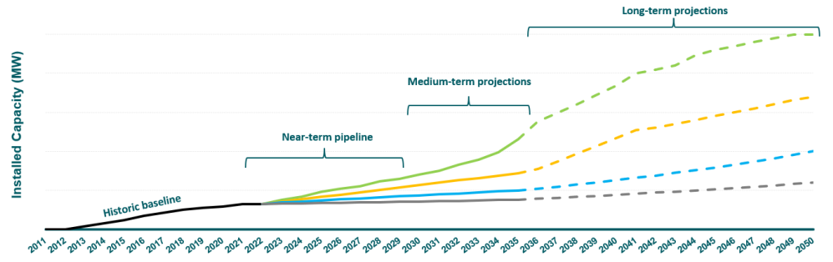
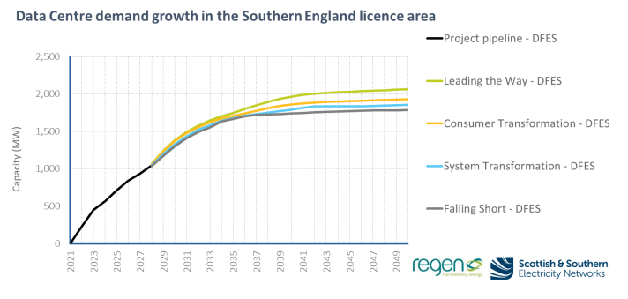
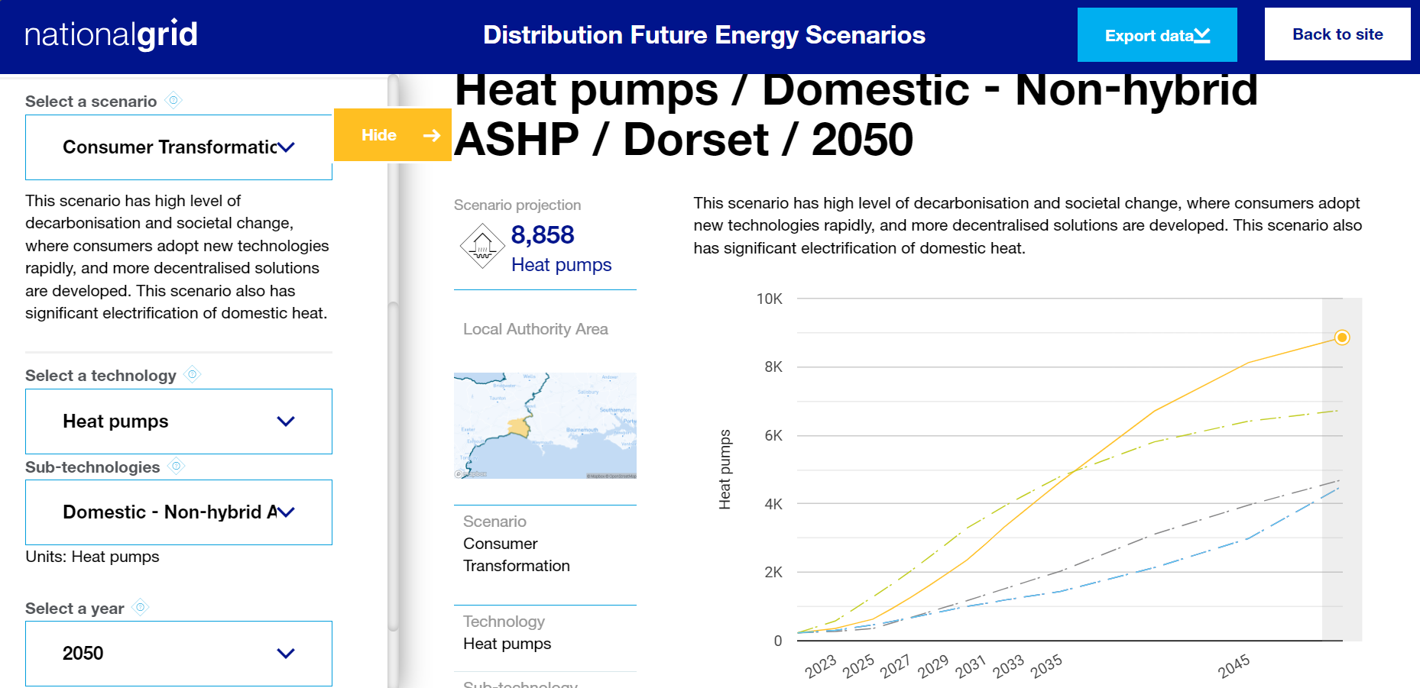

How is demand forecast? Distribution Future Energy Scenarios
SSEN’s
forecasting
There is considerable detail in the forecasting analysis (DFES), projecting growth and deployment estimates locally on a range of factors – from data centre energy demand to heat pumps…
National Grid’s
forecasting
Notes:
What I just showed you was the transmission-level forecasts. But DNOs also undertake annual forecasting for the distribution network too, through their ‘Distribution Future Energy Scenarios’ (DFES) for the local grid. So both SSEN and National Grid work produce these for the areas covered by us.
They use the same framework, definitions and scenarios as the forecasts just mentioned – but uses more local assumptions and more locally detailed forecasts.
This enables them to credibly forecast what, where, when and how much supply or demand tech might connect to the distribution network. This then allows them to plan for reinforcement through new or expanded substations or through flexibility measures, providing the evidence base for investment.
DNOs model generation, demand and storage in order to anticipate future load scenarios and the location and timing of demand locally.
The modelling considers the baseline of operational or connected projects now, and what’s in the pipeline. It then models to the medium and long-term, and distributes these geographically.
The projections are informed by an evidence base that consider technological and socio-economic factors, consumer behaviour assumptions, local authority strategies and plans, and national policy amongst other things. There are of course uncertainties on things like policy, tech, and consumer behaviour – and effort is made to factor these into the scenarios.
They are also informed by engagement with local stakeholders, and DNOs hold multiple consultation and engagement events and actively seek information from local authorities - particularly on development and net zero plans. Many of our officers input into these processes – I and Chris from Planning have just been inputting into SSEN’s for this year, for instance.

Slide 18


How is demand forecast? Business planning
How is demand forecast? Business planning
The forecasts inform the strategic investment process that determine business plans for every 5-year investment period…
Data, analysis and stakeholder input
Scenario forecasting
The DFES near, medium & long-term projections to 2050
Impact Assessment
The Network Development Plan (NDP) uses the DFES to identify future constraints
Options appraisal
The Distribution Network Options Assessment (DNOA) evaluates means to address constraints
Business Planning
The Business Plan outlines the case for future investment for a given RIIO period
The 5-year control periods are called ‘RIIO’ (Revenue = Incentives+Innovation+Outputs)
The current period (2023-2028) is called ‘RIIO-ED2’
Notes:
Those forecasts aren’t just intellectual exercises. They inform the strategic investment process: informing a Network Development Plan, Network Options Assessment, and then finally a business case for future investment – like determining when a Grid Supply Point may need upgrading.
As the network operators are monopolies the network is subject to price controls regulated and set by Ofgem. These controls are known as RIIO.
The Business Plans are produced for 5-year ‘regulatory control periods’ in which investment in which investment is planned. These are submitted to Ofgem for approval, and determine the level of investment that can be undertaken in that period. The current price control period for distribution networks is called RIIO-ED2, and runs from this year until 2028.
SSEN’s 2022 plan, for example, outlines a plan to invest at least £3.5bn in the southern license area to 2028, enabling it to facilitate 8GW of distributed generation and storage, 1.3m EVs, and 800,000 heat pumps.

Slide 19
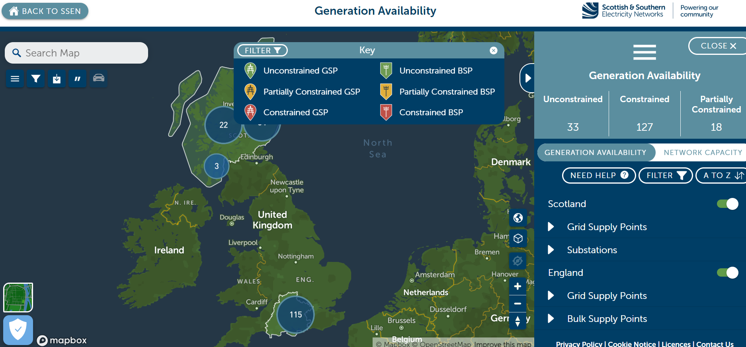
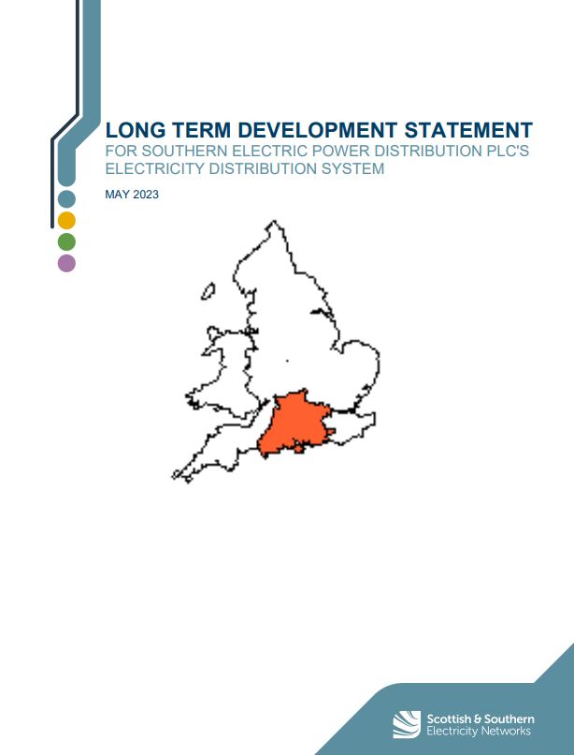
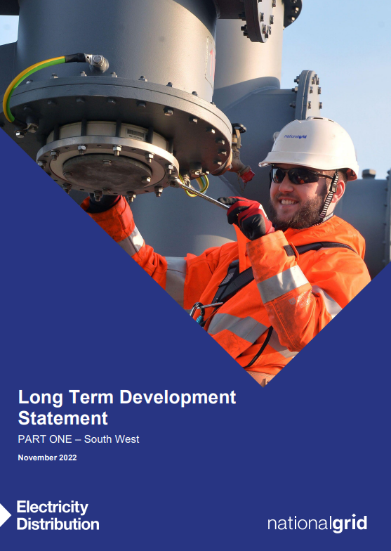

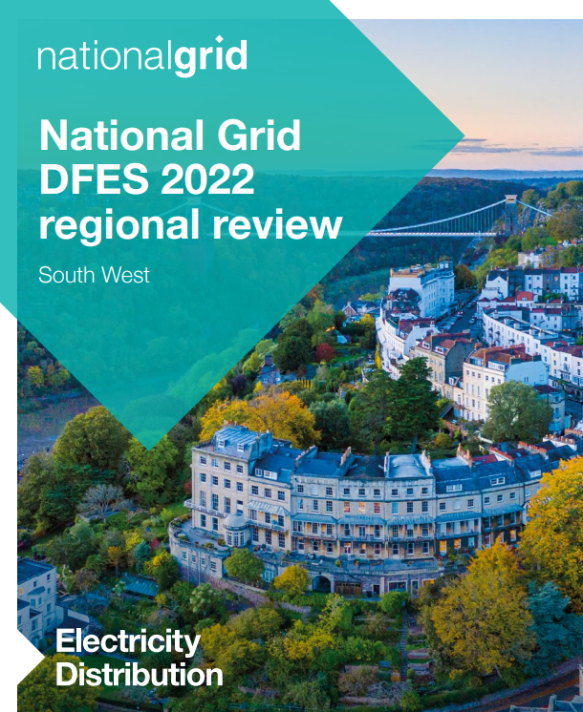

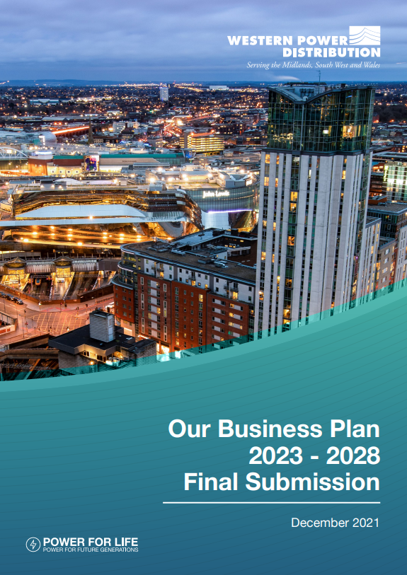

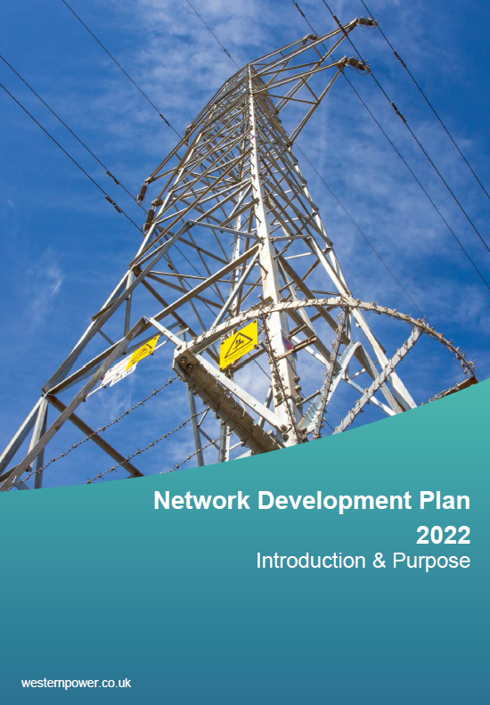
How is demand forecast? Business planning
Information & network planning documents
Heat
Maps
Updated regularly.
Show current constraints and capacity.
Show where reinforcements would most likely be triggered.
Long-term Development Statements
Annual statements (November).
Rolling 5yr view.
Show expected constraints for the next 5 years.
Distribution Future Energy Scenarios
Annual analysis
Scenario-based, projections.
Forecast constraints to 2050.
RIIO-ED Business Plans
Produced for each 5yr RIIO-ED period (now 2023-28).
Approved by Ofgem.
Informed by the DFES.
Network Development Plans
10yr plan.
Show intent…
…but can be modified by new DFES analysis and are subject to Business Plan approval.
Notes:
As such, there are a suite of documents or resources which inform on constraints and plans to address them.
Online heat maps show where there’s currently capacity, or where it’s limited or non-existent. These can help inform developers where connections are more or less likely to trigger reinforcements.
Long-Term Development Statements are annual statements which give a rolling 0-5yr view, showing where is expected to reach capacity in the next 5 years. They’re published each November and updated each May.
Distribution Future Energy Scenarios as just mentioned are annual, scenario-based, long-term projections out to 2050.
Business Plans as also just mentioned are the investment proposals submitted to Ofgem for each 5-year period.
And finally, Network Development Plans incorporate all of those, but give a longer-term 10yr plan to address constraints. But they only show intent: they’re subject to the Ofgem’s agreement of the underlying Business Plans, and can be modified if future forecasting suggests need.

Slide 20
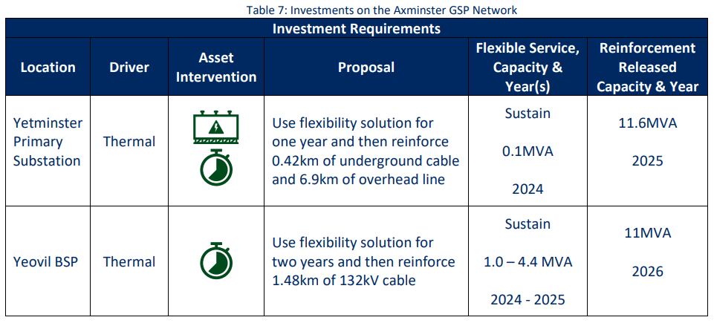
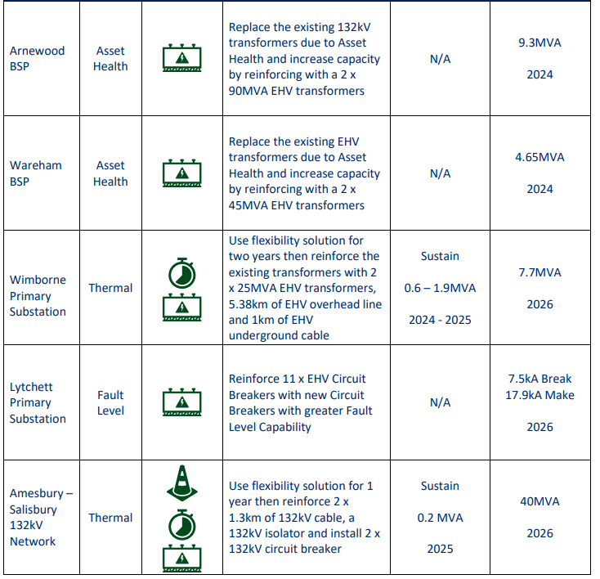
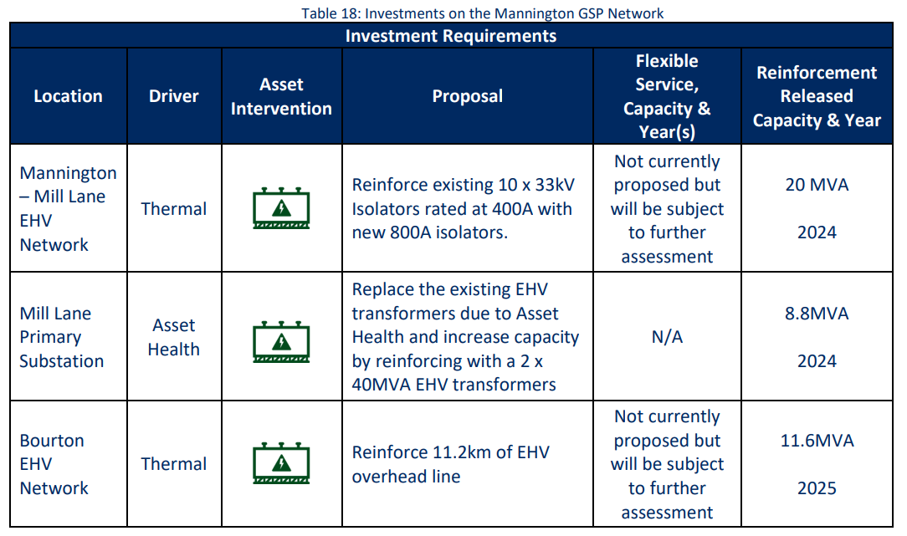
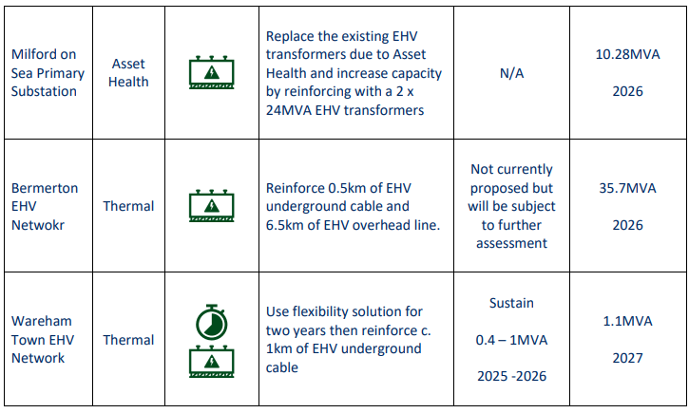
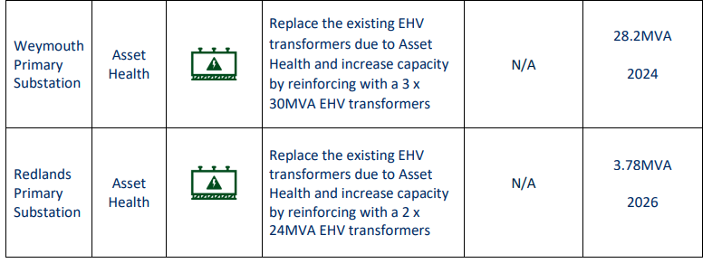
How is demand forecast? Business planning
SSEN’s proposed investments 2023-2028
Axminster
Mannington
Chickrell
14
Notes:
There’s a lot of detail in those, and if you’re interested I’d suggest you go take a look as I can’t cover the detail in the time available here.
But to just briefly exemplify some of the content, this is from SSEN’s last Business Plan, noting investment intent for 2023-2028.

Slide 21
2. The Scrutiny report’s key findings

Slide 22
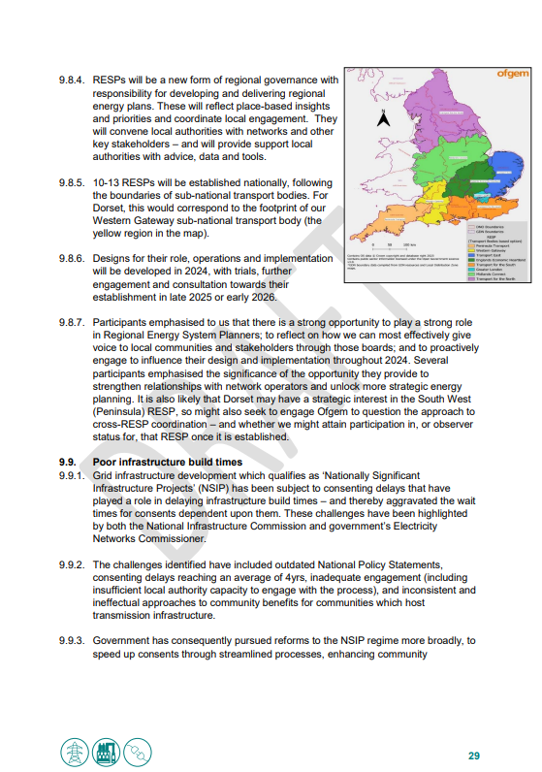
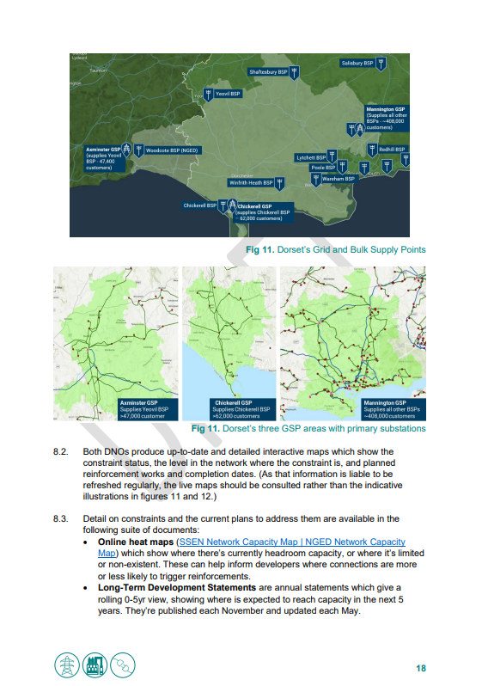
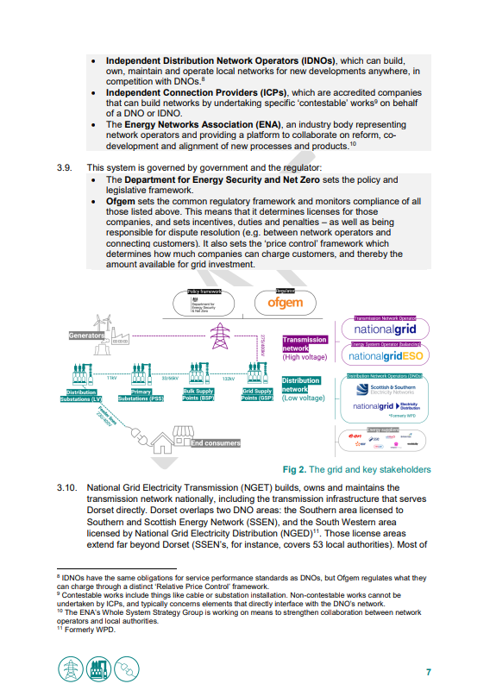
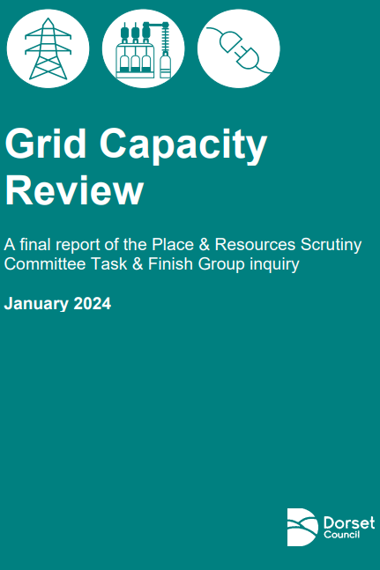
Final report
The final 40 page report contains a summary of the findings, alongside the recommendations from Session 5.
It’s written as a primer for anyone without background knowledge – so should be accessible to anyone who wasn’t engaged in the process.
It also contains briefings on the policy and reform context – which you might find helpful if you need help navigating that.
In a nutshell, the report includes…
Notes:
As I said earlier, a task and finish group of the Place and Resources Scrutiny Committee did a deep dive into this issue earlier this year.
Their final report contains the key findings and recommendations – which were subsequently endorsed by scrutiny and by Cabinet.
It’s written as a primer for anyone who didn’t participate – so if it’s of interest, and I’ve failed (as I no doubt have) to adequately explain stuff over the previous x minutes, then please do take a look at it.
I’ll just here briefly note a few key points from it.

Slide 23
Final report | Key points
Grid constraints are a drag on decarbonisation, business expansion, development, investment and economic growth.
Local projects already face delays, curtailment or cancellation owing to prohibitive connection costs or grid strengthening delays – and in some cases it has impaired project viability entirely. Some are unable to connect until 2036.
But stakeholders identified clear opportunities for the council, such as:
Strengthening the evidence base for local network investment need and the strategic planning of the future grid;
Strengthening collaboration with network companies;
Lobbying to expedite upgrades;
Facilitating constraint mitigations like flexibility measures, microgrids, or alternative low carbon heat sources.
Notes:
First, is that the challenge cannot be understated: grid constraints are now commonly cited as the single biggest barrier to decarbonising power. And if unaddressed its strategic significance is considerable, presenting a drag not just on decarbonisation and energy security, but also on business expansion, development, investment and economic growth.
*Moreover, this is not just an issue for the future. Local projects already face delays, curtailment or cancellation owing to prohibitive connection costs or grid strengthening delays – and in some cases it has impaired project viability entirely. Many local stakeholders have reported being offered connection times as late as 2036, and many identified the contours of these challenges and their impacts – telling us of many major and minor renewables, EV charger and building retrofit projects they had underway which were running into grid capacity issues. Whilst the extent of the projects facing constraints shouldn’t be exaggerated, equally, they are more than an irritant to a sizeable number of projects – and there is a clear identifiable strategic risk that this could become more severe as ever more new sources of low carbon supply, storage and demand aim to connect to the system in the coming decade.
*Just as importantly, however, local stakeholders also endeavoured not to just register their views on the challenge, but to diagnose the challenges and offer prescriptions on the councils potential role in helping to resolve them – whether through strengthening the evidence base for local network investment need and the strategic planning of the future grid; strengthening our collaboration with network companies; lobbying to expedite upgrades; or better facilitating constraint mitigations like flexibility measures such as battery storage, microgrids, or alternative low carbon heat sources.
There’s a lot more detail in the report on what stakeholders told us about the issues and impacts locally which I won’t repeat here, for want of time.

Slide 24
Final report | Key points
Energy infrastructure must be seen through the same lens as other strategic infrastructure, with investment better aligned to local knowledge, ambition and decision-making.
Energy, development and transport are a triad of strategic spatial planning areas in which we have critical strategic interest. Whilst development and transport are more familiar, we’ll have opportunity to play a bigger role in energy in the future.
Our ambitions for net zero, development and economic growth will require us to play a much more central role in local energy planning in the future – and strengthening our collaboration with energy networks will be essential.
Government and Ofgem now have a major programme of reform underway – including through their Transmission and Connections Action Plans. These present councils with strategic opportunities.
Notes:
In a nutshell though, these were the key diagnoses for why the problems existed:
Insufficient strategic anticipatory investment
A lack of strategic network planning
Poor connection queue processes
Poor coordination and governance, especially sub-nationally
Poor infrastructure build times
And immature flexibility markets

Slide 25
Report key points: Recommendations
Establish regular quarterly strategic meetings with network operators
Seize the opportunity of Regional Energy Strategic Planners
Strengthen the evidence on local investment need through a cost-effective approach to a Local Area Energy Plan
Ensure that grid constraints and constraint mitigation measures are embedded in our strategies, policy and decision-making
Explore the opportunities of Ofgem’s Strategic Innovation Fund and our devolution asks
Lobby our MPs, government, Ofgem and network operators
Notes:
In particular, I’m not going to talk through all the recommendations of the task & finish group – but I do want to pick up here on two which have to two with the need for more strategic energy planning at the local and regional scales.

Slide 26
3. Strategic Energy Plans

Slide 27
The emerging strategic planning framework
National scale
Strategic Spatial Energy Plan (SSEP)
Centralised Strategic Network Plan (CSNP)
Regional scale
Regional Energy Strategic Plans (RESPs)
Local scale
Local Area Energy Plans (LAEPs)
Notes:
In response to these challenges, a new national framework for strategic network planning is being established. This comprises:
The Strategic Spatial Energy Plan (SSEP) – this will be a national blueprint for the development of large-scale generation and storage of electricity and hydrogen over time.
Centralised Strategic Network Plan (CSNP) – this will be an independent, coordinated, and long-term approach to transmission network planning.
and Regional Energy Strategic Plans (RESP) – these will provide coordinated whole energy system planning at the regional scale.
Local Area Energy Plans (LAEPs) – these aren’t statutory documents, but many localities have produced them for a more local-scale view, and they could then serve as valuable inputs into RESPs

Slide 28
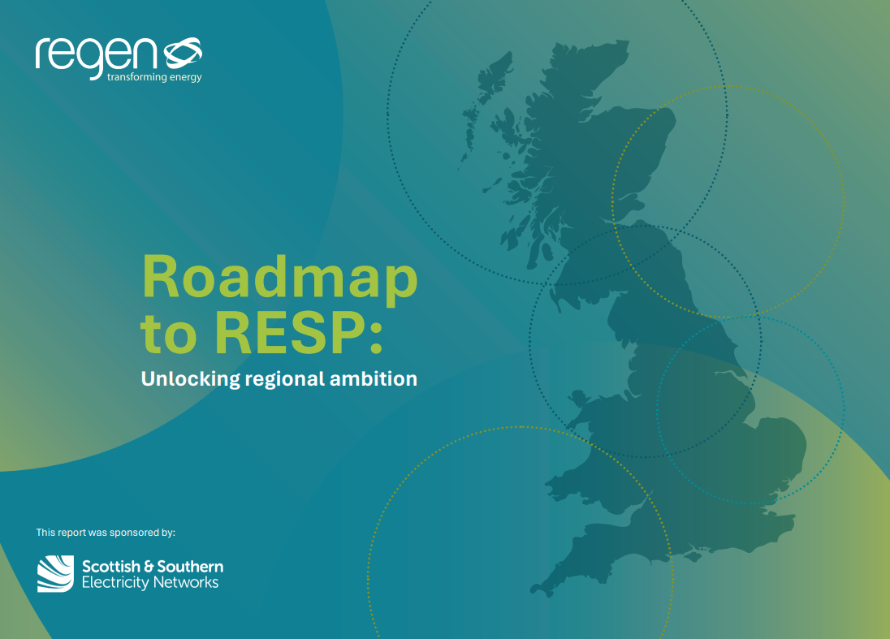
What are RESPs?
Regional Energy Strategic Plans were announced by Ofgem in November.
They will be developed by new regional strategic energy boards (a new regional-scale form of governance for energy. These boards are being established by the new National Energy System Operator (NESO).
They will support planning at the regional scale, and will help to coordinate local government and network companies to better coordinate strategic infrastructure planning.
Councils will play an important role in them by:
  Sharing our local spatial and data-led plans
  Helping to set their regional vision and direction
  Making decisions through the regional Strategic Board
For more info, Regen’s Roadmap to RESP is a helpful guide
Notes:
One of the main big forthcoming changes to ensure better strategic planning for the network will be the introduction of Regional Energy Strategic Plans – which were announced by Ofgem in November.
These are being introduced by Ofgem, will be developed by new regional strategic energy boards (a new regional-scale form of governance for energy), and will be delivered by the new National Energy System Operator (a new non-profit public entity with responsibility for electricity and gas).
They will support planning at the regional scale, and will help to coordinate local government and network companies to better coordinate strategic infrastructure planning. They will enable democratic representatives to have a greater role and influence over network investment. This should support us to better deliver on our development, economic growth and net zero ambitions by helping to better strategically direct network infrastructure decisions.
Currently our engagement with the energy system is piecemeal and project-specific. RESPs should enable us to engage in a more strategic, integrated way that focuses on the whole-system.
Councils will play an important in them role by:
Sharing our local spatial and data-led plans
Helping to set their regional vision and direction
Making decisions through the regional Strategic Board
Ofgem has an open consultation on RESPs – discussing things like their boundaries and governance.
To get the most out of them, we’ll need to prepare effectively…
Doing that will require at least four key things:
1. Build understanding: Build our knowledge about energy networks, their impacts, and their processes and decision-making. That’s partly what we’re doing here today – and we can chat a little more in a bit about what more you think might be helpful to help upskill you.
2. Develop governance: Develop structures to enable representation, flow of information and accountability for primary local energy system stakeholders.
3. Champion local stakeholders: Help to convene wider local stakeholders to best represent their ambitions at the regional scale.
4. Share data: Collate and share local data on things like development, transport, and net zero to help inform the plan.
As we’ve seen, the network is very technical – so there’s a continuing need to build our knowledge and understanding – both as councillors and officers – so that we can effectively participate.
That’s partly what we were doing through the scrutiny task and finish group, and here today.
NESO will also provide training, but we don’t know the details of that yet – but we may be able to help shape that training resource.
In the short term, we need to re-convene our relevant teams and how they can feed in. We’re already working well across sustainability and planning now to feed into the existing DFES processes, so it’ll just be a matter of thinking about how we can strengthen those existing ways of working.
Hopefully though, the clear challenge for councils to engage effectively with RESPs might prompt government to reconsider policy and resourcing here – and the consultation is a route for us to emphasise points such as:
Making net zero or energy planning a resourced statutory function for councils. Ofgem is just the regulator, so can’t address issues like council statutory functions and resourcing – that’s for central government.
Strengthening how energy planning is reflected in existing statutory functions like Local Plans and Local Transport Plans.
Opportunities through devolution
Asks around supporting resource, data and tools from NESO
We’ll have a crucial role in convening local communities, businesses and other stakeholders to feed into the process. This will be important both to ensure it reflects the aspirations of local stakeholders, and to ensure community buy-in for new infrastructure.
We’ll need to identify the best way to do this locally.
There is unclarity about how this will be resourced nationally – but we have already taken steps through the engagement with the grid enquiry; and will be doing more relevant stakeholder mapping and engagement during the initial stages of the LAEP process either late this year or early next – well ahead of the launch of the RESP process.
The RESP consultation is currently underway, with formal responses due by 8 October 2024. However, for local authorities, this is just the start of a new process for engaging with and supporting the planning of the energy system. The outcomes of the consultation will determine the next steps in how the RESP process is designed and the governance structures that will encourage regional participation with that process.

Slide 29
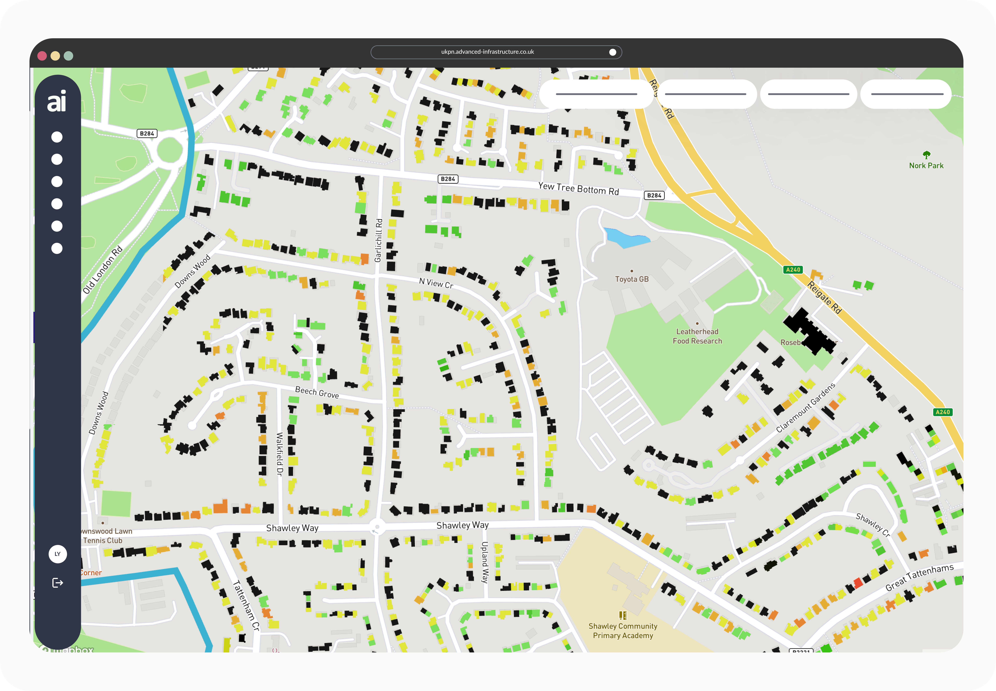
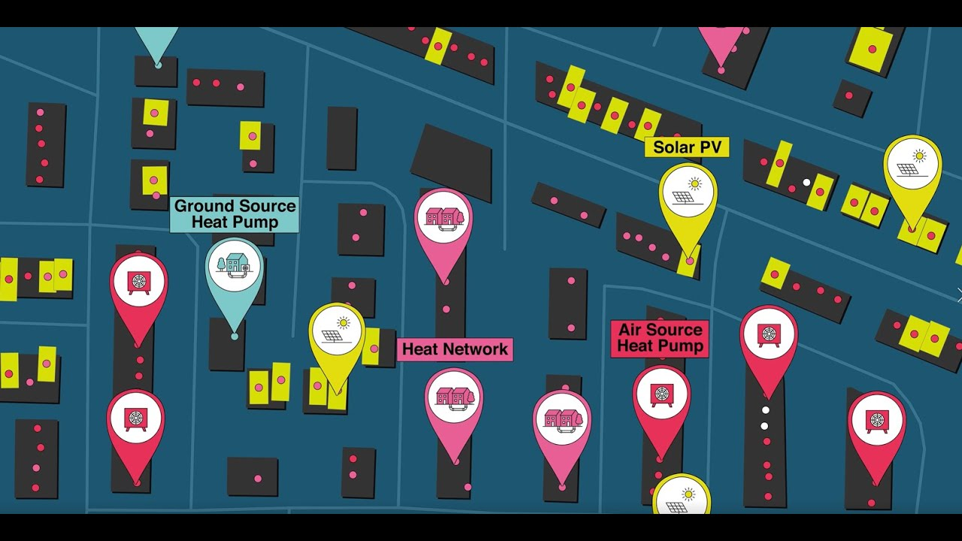
Local Area Energy Planning
This is a relatively new process. Using technical evidence on the whole energy system, and engagement with stakeholders, LAEPs provides an ‘action plan’ for energy using proactive, whole-systems, data-driven approach to energy planning
We’re about to commission a joint exercise with the SW Net Zero Hub for the early engagement stages of a Dorset LAEP
They aren’t statutory and aren’t therefore funded. Some areas have produced them already, but there’s a lot of inconsistency across the country both regarding whether an area has one, and the method by which they’re developed.
Notes:
Local Area Energy Planning (LAEP) is a relatively new process. Using technical evidence on the whole energy system, wider non-technical factors, engagement with stakeholders, and clear governance, LAEPs provides an ‘action plan’ using proactive, whole-systems, data-driven approach to energy planning – which ultimately aims to deliver cost savings and a more managed energy transition.
So far, these aren’t statutory and aren’t therefore funded. Some areas have produced them already, thanks to things like devolution funding, but there’s a lot of inconsistency across the country both regarding whether an area has one, and the method by which they’re developed.
They can be useful if they help develop a pipeline of investible projects; and could help to inform grid investment planning if they are adequately explicit about their spatial intent. In short, network operators need to know not just the high-level ambitions of localities, what where they want to put new sources of energy generation or demand.
Broadly, it includes identifying things like on and off gas properties, energy demand profiles, gas demand profiles, potential rooftop solar and EV charge post opportunities. So, overall, it’s a data-driven approach to understanding spatially what's the best thing to do in an area is, taking into consideration the different
house types, the different industry, different businesses and your aspirations for the region. We'll get to see what sort of heating systems might be appropriate in different neighbourhoods – like whether to go for heat pumps or heat networks in an area – and helps us to understand what might be best to aim for, steet-by-street.
The process is one that's highly collaborative, making sure that the right stakeholders are brought to the table and buy into the plan itself.
LAEPs have recently become a statutory requirement for Welsh local authorities. ‘Trailblazer cities’ like Greater Manchester have adopted LAEPs with ambitious pre-2050 net zero targets across the UK. Over 20 local authorities have LAEPs in the UK. There are significant barriers to roll-out such as the capacity and skills of local authorities, short-term funding, data transparency and a lack of standardisation.

Slide 30
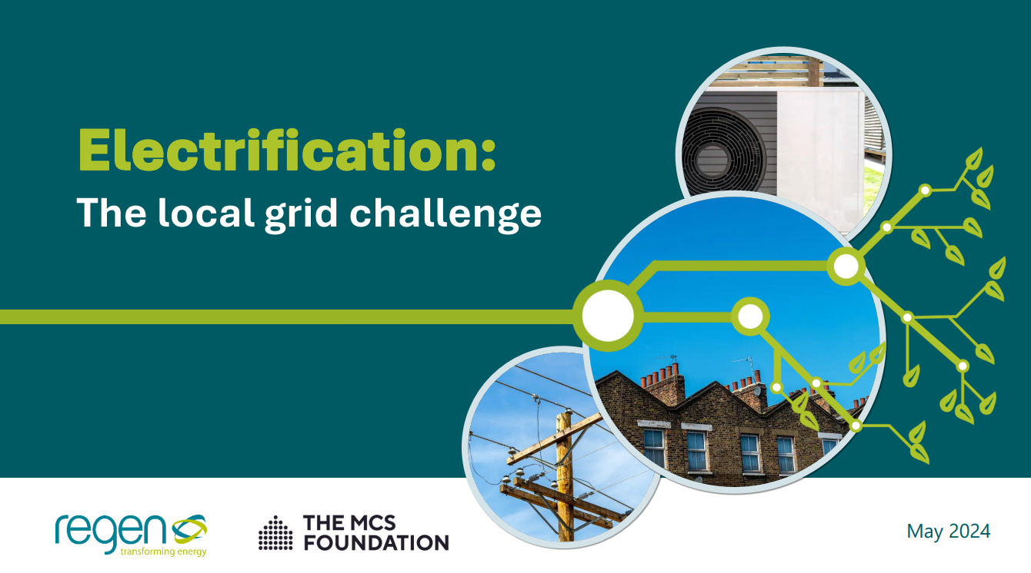
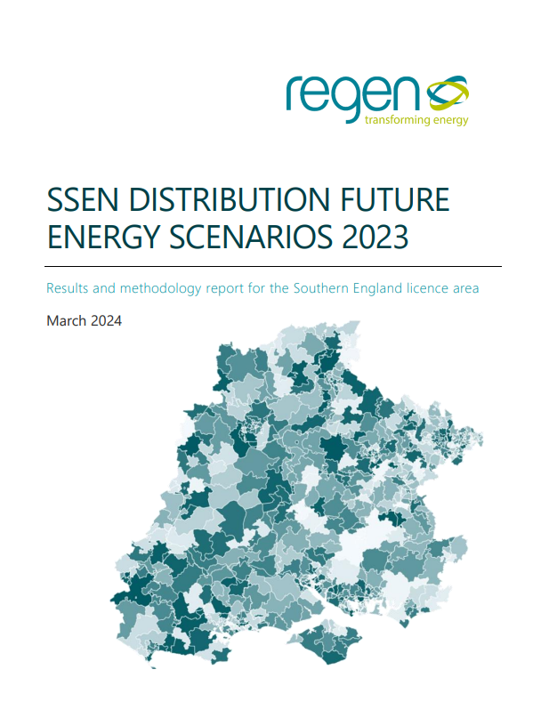
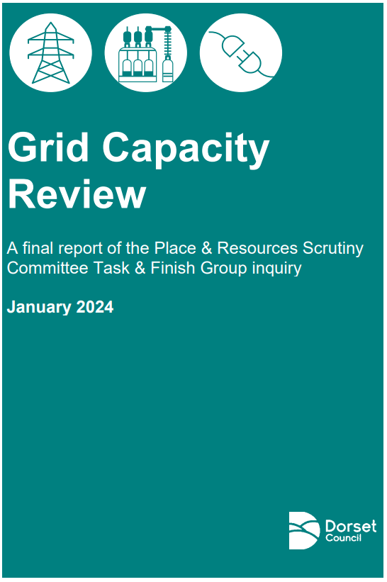
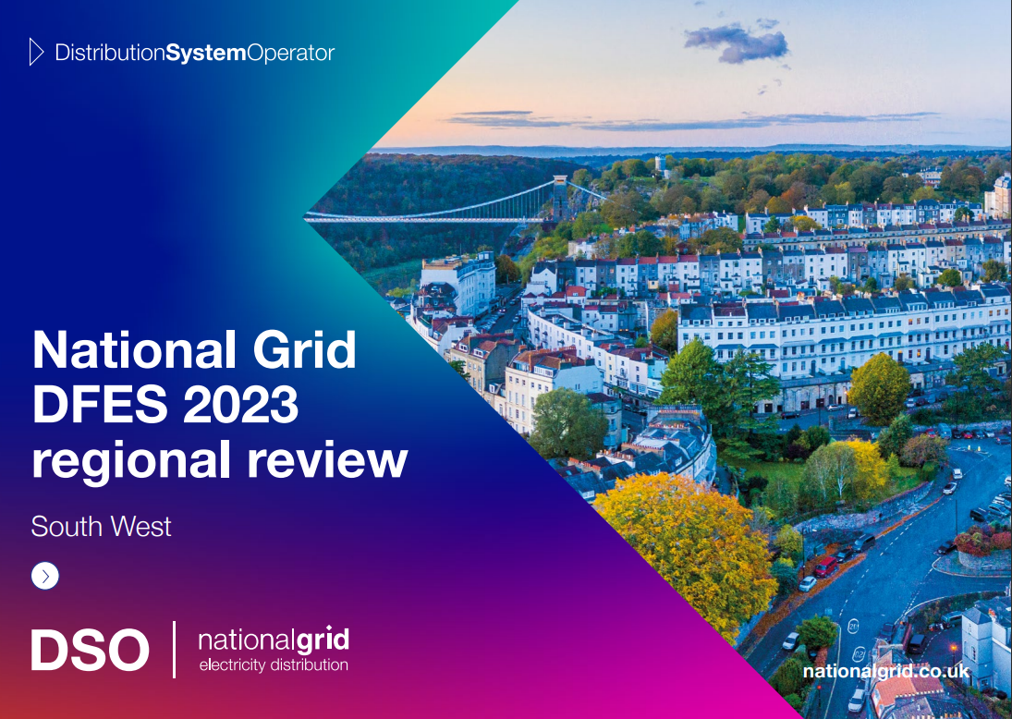
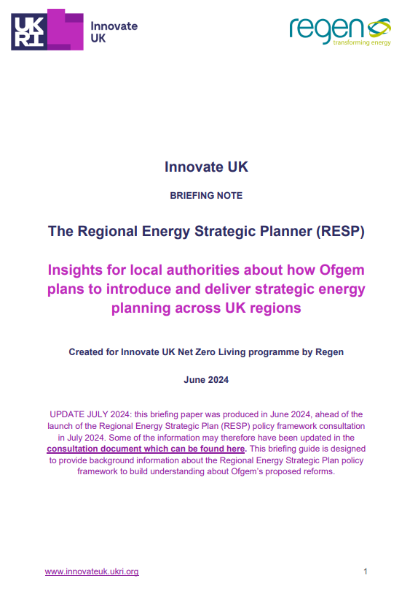
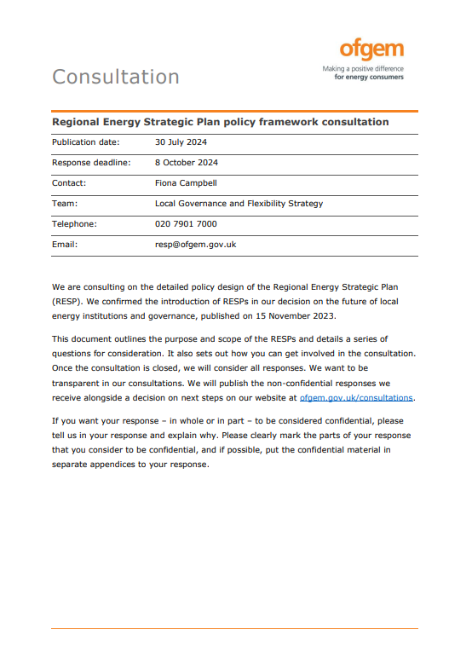
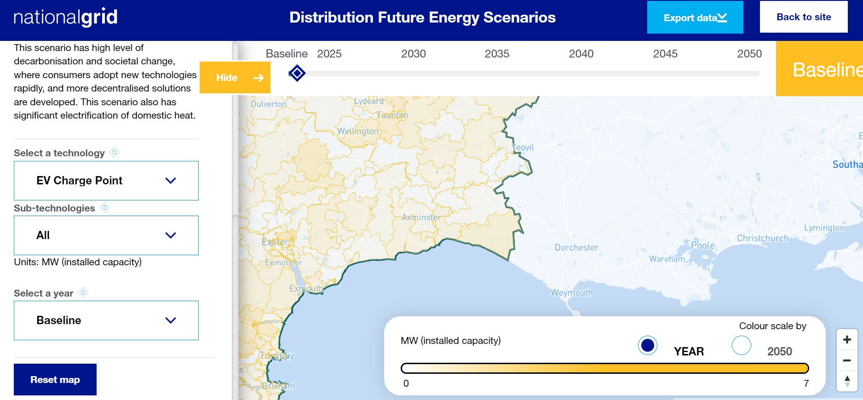
Want to know more?

Slide 31
Thanks
carl.warom@dorsetcouncil.gov.uk
Notes:
Thanks, I just want to conclude by thanking the task & finish group for enduring with this process.
I know it was often a bit intense with some marathon 3 or 4 hour sessions on often really technical matters – so thanks for sticking through it, and I hope you appreciate the subsequent gift of a hefty report to read.in addition
I hope that it’s been a helpful process though, and I know that we as officers also learnt a lot throughout – and it’s also been a pleasure to work with members in this sustained way.
So thanks to the committee for the opportunity.

